Slide 1
MMRI Health and Safety Awareness
Revised August 2025
Brady Semple

Slide 2
Introductions
Key Staff
Dr. Stephen Veldhuis – Director, MPAL
Steve Remilli – Operations Manager
Brady Semple – Facilities Manager
Ellen Mack– Institute Administrator

Slide 3
Laboratories
The MMRI has several different lab areas:
Machine Shop (MMRI 111)
Contains mills, lathes, microscopes, and general machining and fabrication equipment
Waterjet Room (MMRI 109)
Waterjet and welding, grinding, and sandblasting equipment
Materials Property Assessment Laboratory (MMRI 108)
Surface test equipment: indenters, AFM, tribometers, and scratch testers
PVD Coater Lab (MMRI 215)
PVD coater, laser cutter, and associated equipment

Slide 4
MMRI Health and Safety
Objectives
To establish a safe and enjoyable working environment for students, staff, faculty, and guests
To highlight existing documentation available through the Ontario Occupational Health and Safety Act (OHSA) and McMaster University Health and Safety (UHS) - all information presented comes from these sources
To prevent situations that may result in personal injury or death

Slide 5
MMRI Health and Safety
Both supervisors and workers are required to enforce and abide by safe working practices as they have been laid out in this and other training documents. This includes safe and proper use of PPE and all equipment
Maximum fines for corporations are $500,000
Maximum fines for individuals are $25,000 and imprisonment for up to 12 months

Slide 6
MMRI Health and Safety
Key Terminology
Worker: A person who works or provides service for monetary compensation
Employer: A person who employs or contracts for the service of others
Supervisor: A person who has control of a workplace or authority over a worker
PPE: Personal Protective Equipment (e.g., safety glasses, shoes, goggles)
SOP: Standard Operating Procedure
WHMIS: Workplace Hazardous Material Information System
SDS: Safety Data Sheet
UHS: University Health and Safety (formerly EOHSS)
JHSC: Joint Health and Safety Committee
MOL: Ministry of Labour

Slide 7
MMRI Health and Safety
Joint Health and Safety Committee (JHSC)
A tool which workers and management can use to work together to participate in safety discussions and improvement
Acts in an advisory role to encourage awareness and compliance
Undertakes audits and inspections
The MMRI is a member of the MARC JHSC
Any safety concerns can be raised with our JHSC by contacting Brady Semple (semplebg@mcmaster.ca)
Or reach out to any other members of the committee : https://hr.mcmaster.ca/app/uploads/2019/01/JHSC-Master-List.pdf

Slide 8
MMRI Health and Safety
Rights of the Worker
Right to Know:
As a worker, you have the right to be informed by the employer of known or likely hazards in the workplace, and to be provided with the information, instructions, education, training, and supervision necessary to protect your health and safety
Right to Participate:
Workers are allowed to have input on the steps taken by the employer to ensure health and safety. This includes participating in the JHSC, reporting concerns that could affect the health and safety or yourself or your coworkers, and making suggestions to your committee or employer
Right to Refuse:
You have the right to refuse work that could affect your health and safety and that of others. The right to refuse is normally used when the first two rights fail to ensure your health and safety. Exercising this right is serious and should not be done lightly or as a routine method of solving workplace problems

Slide 9
MMRI Health and Safety
McMaster Policies and Programs
Ministry of Labour – Ontario Wide
Central Health and Safety Committee – Campus Wide
Faculty Health and Safety – Engineering Specific
MARC Health and Safety Committee – Only the MARC building and the MMRI

Slide 10
MMRI Health and Safety
Risk Management Manuals/Policies
McMaster University Health and Safety
UHS has developed a ranges of standardized operating policies and procedures for use campus wide
Copies of the policies can be found on the UHS website: https://hr.mcmaster.ca/employees/health_safety_well-being/our-safety/risk-management-manuals-rmms/
The Ontario Occupational Health and Safety Act
OHSA provides additional regulations that are to be followed in the workplace

Slide 11
MMRI Health and Safety
Incident Reporting
Any accidents or incidents in the workplace involving injuries or potential hazards must be reported to your supervisor immediately
McMaster Incident Reporting Form:
https://hr.mcmaster.ca/app/uploads/2018/11/injury-incident-report-fillable-1-36.pdf

Slide 12
MMRI Health and Safety
Incident Reporting
Employee Responsibilities:
Promptly receive appropriate medical treatment. At MIP, Dial 911 for emergency response
Notify your supervisor as soon as possible of injury and any related healthcare measures taken
Assist with the completion of an injury/incident form and sign it
Assist in the incident investigation and implementation of any corrective action
Adhere to the legal requirements of WSIB and participate in McMaster University’s Return to Work Program if modified work and/or lost time results from a work-related injury

Slide 13
MMRI Health and Safety
“Critical Injury” is an injury of a serious nature that includes any of the following:
Places life in jeopardy
Produces unconsciousness
Results in substantial loss of blood
Involves the fracture of an arm or leg
Involves the amputation of an arm, hand, leg, or foot
Consists of burns to a major portion of the body
Causes the loss of sight on an eye
In the case of a critical injury, supervisors are responsible for:
Securing the accident site to ensure that further injury is prevented
Immediately arranging for medical and emergency assistance by calling Security at “88” or “5555” at host hospitals and “911” at any other off-campus locations
Immediately notifying Environmental and Occupational Health Support Services at 905-525-9140x24352 and communicating details of the incident
Ensuring that the site remains undisturbed until Environmental and Occupational Health Support Services provide clearance
Cooperating with directives from Environmental and Occupational Health Support Services and the Ministry of Labour

Slide 14
MMRI Health and Safety
McMaster has a range of standard safety courses that MUST be completed before you can begin to work at the MMRI.
A training matrix developed by UHS is available here: https://hr.mcmaster.ca/app/uploads/2019/02/Corporate-Training-Matrix.pdf
Sign up for required training through Mosaic (https://mosaic.mcmaster.ca/)
A summary of the MMRI relevant courses is presented here:
Mandatory For Everyone: | MMRI Required: | Equipment/Role Specific
SAFE Training Health & Safety Orientation​ Violence & Harassment Prevention​ WHMIS 2015​ | Chemical Handling and Spills​ Ladder Safety​ Machine Guarding Awareness​ Noise Awareness | Gas Cylinder (welding and coater)​ Laser Safety (laser cutter)​ Lock-Out/Tag-Out (maintaining equipment)​ Fire Warden (Brady, Kevin, Dr. Veldhuis, Michelle)​ Accident Investigation (supervisors)​ Due Diligence (supervisors)

Slide 15
Working in the MMRI – General Safety
Emergencies
In the event of an emergency, call 911
Our location is 230 Longwood Road South, Hamilton, Ontario
If time and the incident conditions permit, follow up with a call to McMaster security through either:
Telephone: 905-525-9140 x24281
The McMaster Security App

Slide 16
Working in the MMRI – General Safety
Fire Safety
When an alarm sounds, secure equipment in a safe condition and leave the building by the nearest exit immediately
Do not use elevators
Feel doors before opening them. If hot, find a different exit
Close all doors behind you as you evacuate
If it is unsafe to evacuate, close doors and block cracks with a damp towel. Call 911 immediately
Do not re-enter building until given an explicit all-clear by a fire warden, fire department, or security
*If you require any special accommodations in order to evacuate the building safely, discuss them in advance with your supervisor

Slide 17
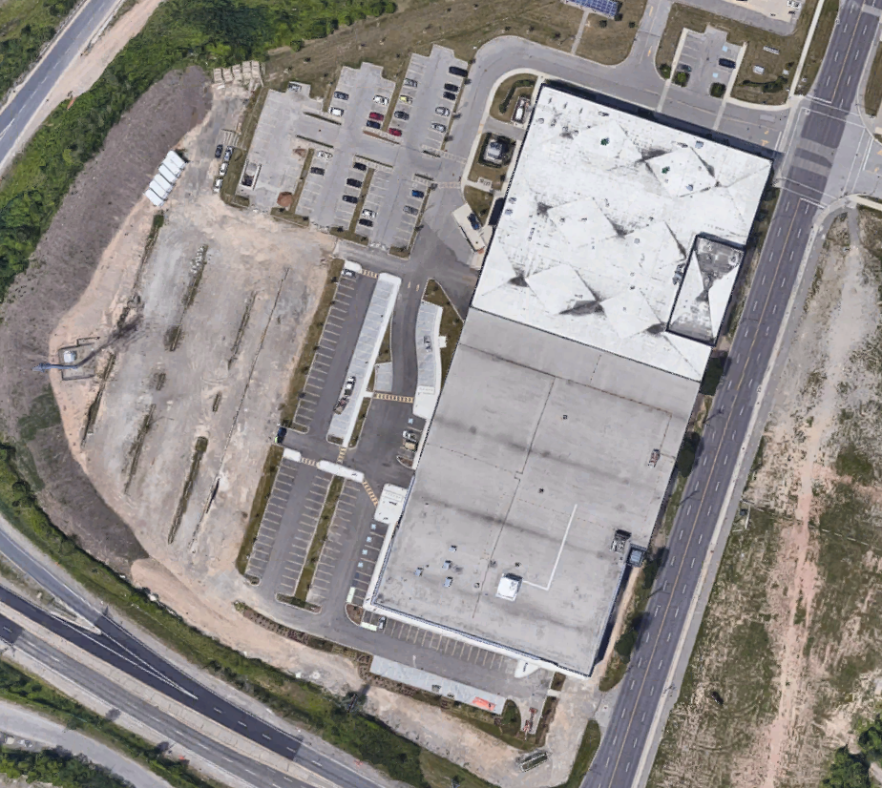
Working in the MMRI – General Safety
Fire Safety – Muster Point
When evacuating the building, leave via the nearest exit
Make your way around the building to the MMRI’s muster point: Across the road from the MMRI main entrance, West of the building

Slide 18
Working in the MMRI – General Safety
Safety Data Sheets (SDS):
McMaster has moved to using an online SDS system
SDS sheets can be found here: https://jr.chemwatch.net/chemwatch.web/account/autologinbyip (no sign in required if logging in from campus)
A lab laptop in the SouthWest corner of the Machine Shop has a link to this address on the desktop
If you are bringing any chemicals into the laboratory that are not found in this SDS listing, let your supervisor know before bringing it into the lab

Slide 19
Working in the MMRI – General Safety
Hazardous Waste Disposal
All chemical waste must be handled properly, not dumped down drains
For solvents, disposal containers are available in MPAL
For waste oil and machine coolant, there are disposal bins in the Machine Shop
If either container is full, let your supervisor know so that it can be emptied
If you have any special waste to dispose of, let your supervisor know

Slide 20
Working in the MMRI – General Safety
Only operate equipment that you have been trained and approved to use by your supervisor
If you have any questions, concerns, or doubts, ask your supervisor for help
Alteration to machines and equipment is prohibited without specific authorization
Floors, walkways, and work areas should be kept clean, clear, and tidy at all times
Spills and damage to equipment must be reported immediately to your supervisor
Never leave equipment running unattended without explicit permission

Slide 21
Working in the MMRI – General Safety
Hours of Operation
The MMRI operates on weekdays (excluding days when the university is closed)
8:30 AM until 5:00 PM
Stop operating equipment by 4:30 PM in order to give enough time to clean up before end-of-day
If special circumstances require that you work on any equipment in the MMRI outside of these hours, inform your supervisor so that arrangements can be made
McMaster has Working Alone policies that dictate the University’s process: https://hr.mcmaster.ca/app/uploads/2022/05/RMM-304-Working-Alone-Program.pdf
When operating machinery, another member of the MMRI must be present

Slide 22
Working in the MMRI – General Safety
Electrical
Use extension cords only when necessary
Extension cords should never be used for stationary/permanent purposes
If you find a cord in poor condition, make your supervisor aware of it immediately. Do not use it
Your supervisor will repair or dispose of the cord in question
Mark and tape down all extension cords as necessary
Do not alter or repair electrical equipment unless authorized to do so
Abide by lock-out tag-out procedures when working on equipment

Slide 23
Working in the MMRI – General Safety
Consequences
Failure to follow the rules and policies outlined in this and other safety training will result in a warning and expulsion from the lab until the safety issue can be remedied
Repeated offense will result in a written notice to the offender and their supervisor
If an offender shows a repeated disregard for or inability to follow safety requirements, then they will be banned from the lab environment

Slide 24
Working in the MMRI – General Safety
General Attire in lab spaces
Closed-toe shoes
Full-length pants
No watches, rings, necklaces, or loose clothing – this can get caught in machinery and pose a serious risk
Long hair should be tied back and/or tucked in to reduce risk

Slide 25
Working in the MMRI
Headphones
No headphones or earbuds are allowed to be worn in the MMRI except in the desk areas
They reduce your awareness of what is going on around you, and make it difficult for your coworkers and supervisor to alert you of hazards
While headphones can reduce the perceived volume of sounds around you, they are not hearing protection, and the music played through them adds to the noise level you are experiencing

Slide 26
Working in the MMRI
PPE
Safety glasses and safety shoes must be worn in the:
Waterjet Lab
Machine Shop – Any point within the yellow lines on the floor
Safety glasses and shoes must be CAS approved designs
Shoes will have a green triangle indicating such
Additional PPE requirements depending on the task at hand:
Hearing protection (always required in waterjet room when waterjet is running)
Gloves (when handling material but NEVER when working on machinery with rotating components)
As needed (discuss with staff to arrange special PPE to be supplied)

Slide 27
Working in the MMRI
PPE
MPAL
Safety Shoes – recommended but not required
Safety Glasses – recommended but not required
Gloves (Nitrile) – required with AFM, indenters, microscope turrets. Recommended with all equipment and samples
Coater Lab
Safety Glasses – when working in coating chamber
Safety Shoes – when performing maintenance or replacing parts
Gloves – when working in coating chamber

Slide 28
Working in the MMRI
PPE – Special Events
Tours:
It may be necessary to have a tour group through the lab where not all members of the tour have complete PPE
If this is the case:
Provide everyone with safety glasses from the rack at the front (West) of the lab
Warn people within the lab that a tour is coming through
Escort the members of the tour, do not allow them to roam freely
Make sure that all material handling activities (cranes, forklifts, pallet trucks, etc.) are kept well away from the tour
You are responsible for the members of the tour group
Events:
Very rarely, special events like an open house may allow PPE requirements to be fully relaxed. Your supervisor will communicate this well in advance

Slide 29
Working in the MMRI
Material Handling
Material handling is a common source of injury
For heavy materials, ask a staff member for help to use an overhead crane or forklift for you
Be aware of sharp edges and corners. Use gloves to protect your hands from cuts and scrapes
Be careful when stacking material. Do not make unstable stacks, and secure loads properly

Slide 30
Working in the MMRI
Cut Hazards
Many of the materials in the machine shop are inherently sharp. Tooling and workpieces in particular pose risks
Knives, scissors, deburring tools, and other hand-held cutting edges are also frequently used in the labs. Handle with caution, and never draw a knife or other cutting tool towards your hands or body
Do not run fingers along edges of workpieces, especially if they have not been thoroughly de-burred
Be careful when handling cutting tools, especially if oily (such as when removing them from a machine)
If you drop something sharp, move your feet out of the way and do not attempt to catch it. Allow it to fall to the floor

Slide 31
Working in the MMRI
Compressed Air
Compressed air is present throughout the lab space in various hoses and plumbing
Be aware that compressed air represents an enormous store of energy
No not modify, adjust, or otherwise handle compressed air line or systems without specific permission from your supervisor
Make sure not to allow air lines to run across walkways or aisles
Do not use compressed air to clean yourself, your clothing, or any other person. Compressed air pointed at your skin is a serious potential danger
Avoid using compressed air to clean machinery except where absolutely necessary

Slide 32
Working in the MMRI
Clean-up
Be sure to clean your workstation at the end of every day
This includes:
Putting tools away
Cleaning and wiping down surfaces
Disposing of rags or any other waste
Labeling samples and tooling and storing them in project boxes
Make sure samples and sample boxes are clearly labelled with your name and the project code
At the end of the job, fully clean off the equipment
Remove any special fixturing and workpieces
Break down tooling assemblies and put away
Put away any data acquisition equipment
Put all workpieces and samples in your project box. Anything left at the equipment will be disposed of
Coat any steel surfaces in oil, to prevent corrosion, where applicable

Slide 33
Working in the MMRI – Machine Shop and Waterjet Room
Machinery and Training
The Machine Shop contains a range of high powered and potentially lethal equipment
Do not operate equipment within the machine shop that you have not been trained to use
Discuss training needs with one of the staff or your supervisor. Observing a student operating a piece of equipment does not replace proper training
If it has been a while since you used a machine or piece of equipment, do not be afraid to ask one of the staff to provide you with a refresher
If you have any doubts or concerns about your setup or process, review it with one of the staff members
When welding, grinding, or performing other activities that generate fumes or odors, use the snorkel built into the room. Make sure that it is working by listening to it as it starts up

Slide 34
Working in the MMRI – MPAL
Machinery and Training
MPAL contains a range of sensitive equipment, all of which have moving components. Therefore, please keep loose clothing and hands away from any moving parts
Do not operate equipment that you have not received training for. Discuss training needs with one of the staff or your supervisor
Do not make any attachment changes without first consulting the staff in charge
Do not provide training to others unless you have been designated to do so by a supervisor
If it has been a while since you last used a piece of equipment, do not hesitate to ask one of the staff members in charge for a refresher or even a complete training session
If you have any doubts or concerns about your setup or process, review them with one of the designated staff members. Next to each piece of equipment, you can find the SOP. Always adhere to these SOPs

Slide 35
Working in the MMRI – Coater Lab
Machinery and Training
The coater is equipped with a variety of high-powered connections, so caution is essential when working around them
Do not attempt to operate the coater or touch any of its components unless you have received proper training and/or have been assigned by a supervisor
Exercise caution around hot surfaces after deposition and when the chamber is open
When closing the door, be mindful of the vacuum suction to avoid any hand-related incidents
Do not handle the gas cylinders unless you have obtained proper training and permission from a supervisor. Operate with care and adhere to appropriate safety procedures
The snorkel should be in use while a deposition cycle is in progress

Slide 36
Working in the MMRI – MPAL and Coater Lab
Chemical Handling
Only chemicals like Acetone, Isopropanol, and Ethanol are permitted for use in MPAL and the Coater lab
Ask the staff in charge before using any chemical
Carefully handle the chemicals to avoid spills, and use gloves
Make sure not to inhale or expose cuts to the chemicals
Proper disposal containers must be used. Ask the staff in charge before disposing of any chemical if you are not sure about the proper chemical disposal procedure

